Slide 1
ARRAYS

Slide 2
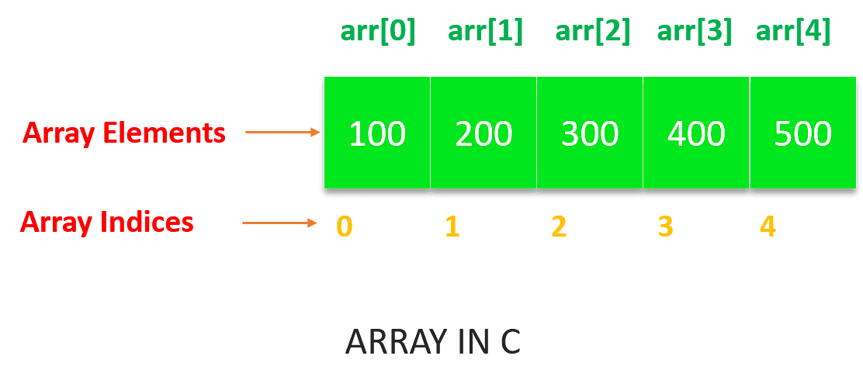
Arrays:
Array is a fundamental data structure in C.
An array is a collection of similar types of data items stored in a single unit.
One or more values same data type, which may be primary data types (int, float, char), or user−defined types such as struct, or pointers can be stored in an array.
The size of the array, also called the length of the array,
Once declared, the size of a array cannot be changed.

Slide 3
Array declaration:
To declare an array in C, to specify the type of the elements and the number of elements to be stored in it.
Syntax:
datatype arrayName [ Size ]; EX: int number[5];
Datatype → specify the type of element stored in array
arrayName → giving name to array
Size → number of elements present in the array
Note:
The Size must be an integer constant greater than zero and type can be any valid C data type. The size is put inside the square brackets.

Slide 4
Array initialization:
Syntax:
data_type array_variable_name[size] = {list of value};
Example:
To store 5 (10, 20, 30, 40, 50 ) elements in an array.
int number[5] = {10, 20, 30, 40, 50 };
Number[0]
Number[1]
Number[2]
Number[3]
Number[4]
10
20
30
40
50

Slide 5
Example:
int counter[] = {10,20,30,40,50}; // array with integer
char name[] = {‘j’, ‘o’, ‘h’, ‘n’}; // array with char
char name[] = “john”; // array with string
int number[5] = {10, 20};
number[0] = 10
number[1] = 20
number[2] = 0
number[3] = 0
number[4] = 0
Ex:
int x[5] = {2, 4, 5, 6, 8};
cout << x[0] << endl;
cout << x[1] << endl;
return 0;

Slide 6
Types of array:
One dimensional array
Two dimensional array
Multi dimensional array
One dimensional array:
Syntax:
datatype arrayName [ Size ];
Example:
int number[5];

Slide 7
Declaring uninitialized array:
Example:
int a[5];
In such type of declaration, the uninitialized elements in the array may show certain random garbage values.
Program:
#include<iostream>
using namespace std;
int main() {
int arr[5];
int i;
for(i=0; i<=4; i++){
cout << arr[i] << endl;
}
return 0;
}
Output:
0
0
56
0
0

Slide 8
Declaring initialized array:
Example:
int arr[5] = {1,2,3,4,5};
Program:
#include<iostream>
using namespace std;
int main(){
int arr[5] = {1,2,3,4,5};
int i;
for(i=0; i<=4; i++){
cout << arr[i] << endl;
}
return 0;
}
Output:
1
2
3
4
5

Slide 9
Program:
#include<iostream>
using namespace std;
int main(){
int arr[5] = {1,2};
int i;
for(i=0; i<=4; i++){
cout << arr[i] << endl;
}
return 0;
}
Output:
1
2
0
0
0

Slide 10
Program:
#include<iostream>
using namespace std;
int main(){
int arr[5] = {1, 2, 3, 4, 5};
cout << "Size of array : " << sizeof(arr);
return 0;
}
Output:
size of array: 20

Slide 11
Program:(one dimensional array)
#include<iostream>
using namespace std;
int main(){
int arr[5] = {1, 2, 3, 4, 5};
int i, sum =0;
for(i=0; i<=4; i++){
cout << arr[i]<< endl;
sum = sum + arr[i];
}
cout << "Sum " << sum;
return 0;
}
Output:
1
2
3
4
5
Sum 15

Slide 12
Program:(user input)
#include<iostream>
using namespace std;
int main(){
int arr[5];
int i;
cout << "Enter values : " << endl;
for(i=0; i<5; i++){
cin >> arr[i];
}
cout << "Elements are : \n" ;
for(i=0; i<5; i++){
cout<<arr[i] << "\t";
}
return 0;
}
Output:
Enter values :
1
2
3
4
5
Elements are :
1 2 3 4 5

Slide 13
Two dimensional array:
Syntax:
data_type array_name [row_size][column_size];
Initializing two dimensional array:
Example:
int tabe[2][3] = {0,0,01,1,1};
int table[2][3] = {{0,0,0},{1,1,1}}
Assign the values as follow,
table[0][0] = 0
table[0][1] = 0
table[0][2] = 0
table[1][0] = 1
table[1][1] = 1
table[1][2] = 1
0 1 2
0 0 0 0
1 1 1 1

Slide 14
Program:(two dimensional array)
#include<iostream>
using namespace std;
int main(){
int i, j, a[10][10], b[10][10], d[10][10], r, c;
{
cout<<"Enter the rows and columns value"<<endl;
cin >> r >> c;
cout<<“Enter the first matrix value\n";
for(i=0;i<r;i++){
for(j=0;j<c;j++){
cin >> a[i][j];
}
}

Slide 15
cout<<"Enter the second matrix value\n";
for(i=0;i<r;i++){
for(j=0;j<c;j++){
cin >> b[i][j];
}
}
cout<<"The addition matrix is\n";
for(i=0;i<r;i++){
for(j=0;j<r;j++){
d[i][j] = a[i][j]+b[i][j];
cout << d[i][j] << "\t";
}
cout << endl;
}
return 0;
}

Slide 16
Output:
Enter the rows and columns value
2 2
enter the first matrix value
1 1
1 1
Enter the second matrix value
1 1
1 1
The addition matrix is
2 2
2 2

Slide 17
Multi dimensional array:
Array of more dimensions are called multi dimension array.
Syntax:
data_type array_name[s1][s2][s3][s4]……[sn]
where,
s → size of dimension:
Example:
int survey[3][5][2];
float table[5][4][5][3];

